Slide 1


Slide 2
Topics around the image acquisition process
Tópicos alrededor del proceso de adquisición de imágenes
By:
Juan Carlos Briñez De León MSc, PhD(c).
Doctorado en Ingeniería de Sistemas e Informática
Universidad Nacional de Colombia
Medellín-Colombia

Slide 3
Outline
1. Light sensitivity.
3. Commercial light sources.
4. Spectral reflectance
5. Spectral response in camera sensors.
6. Color generation process.
7. Bayer and demosaicking effect.
8. Gain of color channels
9. Resolution effect.

Slide 4
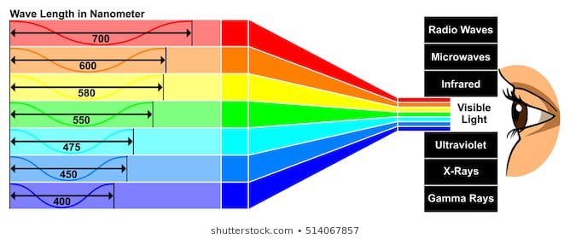
Light sensitivity: Visible light spectrum
What light can we see?.

Slide 5
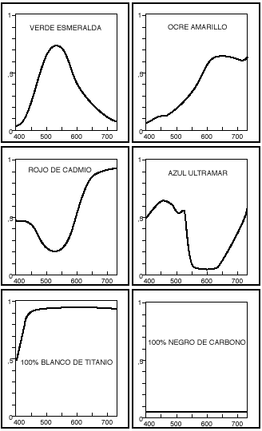
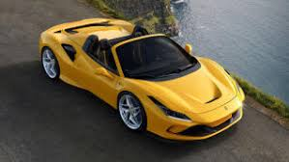

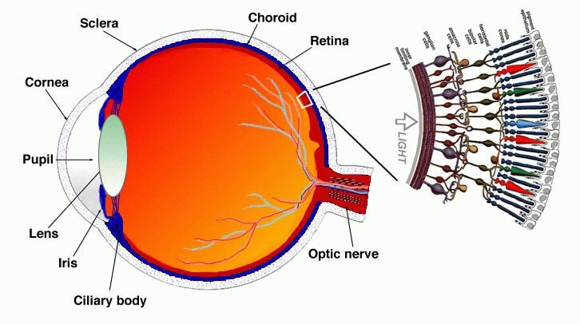
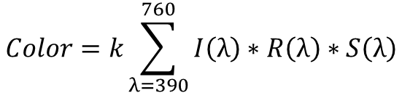
Light sensitivity: Visible light spectrum
Perception
Object
Light
Sensor
$$Color=k\sum_{λ=390}^{760}{I\left(λ\right)∗R\left(λ\right)∗S\left(λ\right)}$$
http://bloglavisionhumana-biofisica2015.blogspot.com.co/2015/09/la-luz-sellama-luz-del-latin-lux-lucis.html

Slide 6
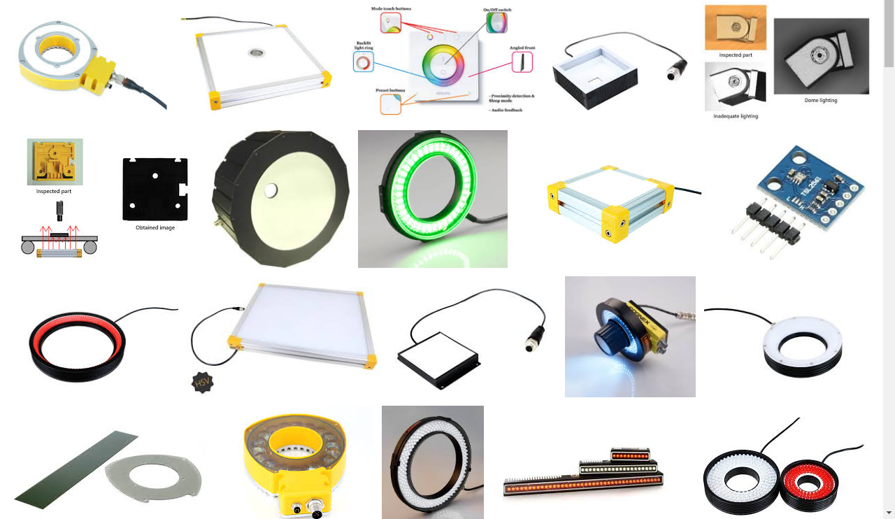
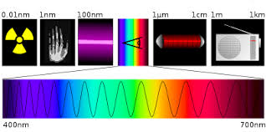


Commercial light sources
$$I\left(λ\right)$$
$$λ$$
What could be the ideal light source?

Slide 7
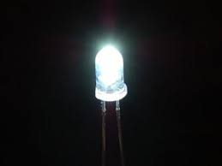
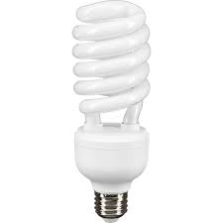
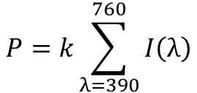
Commercial light sources
$$P=k\sum_{λ=390}^{760}{I\left(λ\right)}$$
390nm
760nm

Slide 8

Commercial light sources: Computational exercise
%***********************************************************************************
%Juan Carlos Briñez
%Doctorado Ing.Sistemas
%Facultad de Minas.
%Universidad Nacional de Colombia.
%======================================================================================
%Algoritmo: Contenido espectral de fuentes de iluminación
%Usando: Rawdata by Juan Sebastián Botero
%======================================================================================
https://discuss.pixls.us/t/spectral-emissions-from-modern-light-sources-more-graphs-added/11588

Slide 9
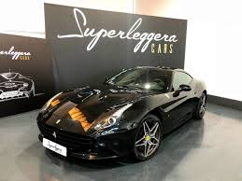
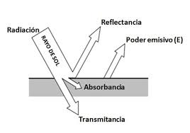
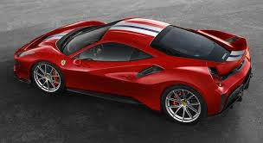
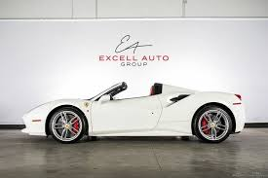

Spectral reflectance
$$R=f\left(λ\right)$$
390nm
760nm

Slide 10
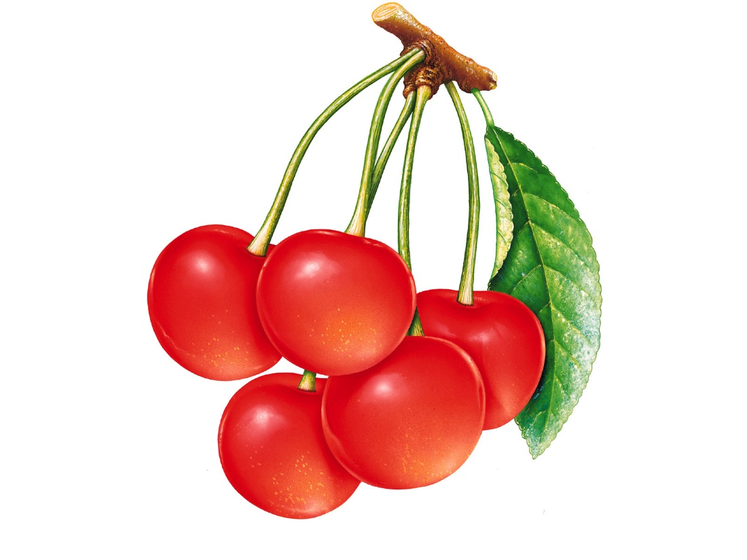


Spectral reflectance in full field
$$R\left(λ\right)$$
Filas
760nm
$$λ$$
760nm
390nm
Columnas
Respuesta espectral en cada punto del objeto.
390nm

Slide 11
Spectral reflectance in full field: Computational exercise
Full_espectro=zeros(371,Fi,Col);
for i=1:Fi
for j=1:Col
C=0;
if Img(i,j,3)>180
Full_espectro(1:371,i,j)=1;
C=1;
end
if Img(i,j,1)>180&&Img(i,j,2)<150
Full_espectro(211:300,i,j)=1;
C=1;
end
if Img(i,j,2)>180&&Img(i,j,2)<100
Full_espectro(141:230,i,j)=1;
C=1;
end
if C==1
Full_espectro(1:371,i,j)=Sources(3);
end
end
end
Ojo: la dificultad experimental radica en el hecho que las escenas no reportan la reflectancia espectral para cada una de sus ubicaciones espaciales.

Slide 12
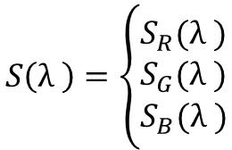
Spectral response of sensors: Human vision
Sørensen, B. E. (2013). A revised Michel-Lévy interference colour chart based on first-principles calculations. European Journal of Mineralogy, 25(1), 5-10.
$$S\left(λ \right)=\left\{\begin{matrix}S_{R}(λ ) \\ S_{G}(λ ) \\ S_{B}(λ )\end{matrix}\right.$$
390nm
760nm

Slide 13
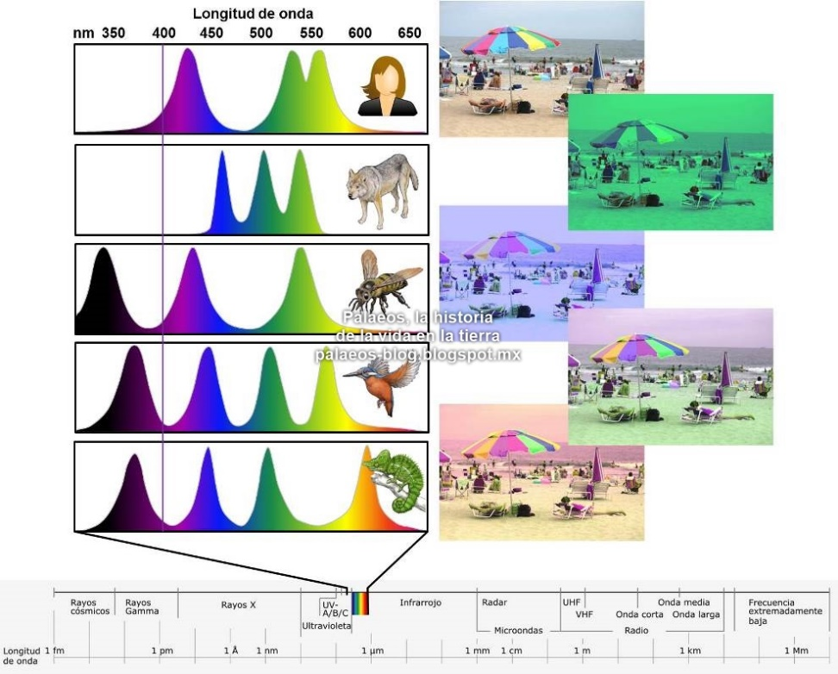

Spectral response of sensors: Animals
Similar scene, different perception:
$$S\left(λ \right)=\left\{\begin{matrix}S_{R}(λ ) \\ S_{G}(λ ) \\ S_{B}(λ )\end{matrix}\right.$$
390nm
760nm
http://palaeos-blog.blogspot.com.co/2013/04/notas-cortas-el-tarsero-y-la-evolucion.html

Slide 14
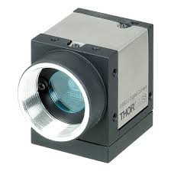
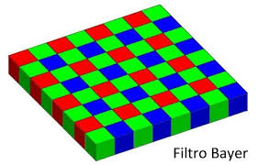



Spectral response of sensors: Cameras
Cámara DCC 3260C
$$S_{G}(λ )$$
$$S_{B}(λ )$$
Spectral filters
$$S_{R}(λ )$$
Thorlabs

Slide 15
Spectral response of sensors: Computational exercise
%Leyendo respuesta espectral del sensor de la cámara
load('Parametros\Cámaras\Sensores_Hermes_2.mat');%Respuesta espectral del dispositivo
%Sensores(:,:,1) => Sensor_0.mat: Ojo Humano
%Sensores(:,:,2) => Sensor_1.mat: Cámara=DCC1240C Sensor=e2v-EV76C560ACT
%Sensores(:,:,3) => Sensor_2.mat: Cámara=DCC1645C Sensor=Aptina-MT9M131
%Sensores(:,:,4) => Sensor_3.mat: Cámara=DCC3260C Sensor=Sony-IMX249LQJ-C
%Sensores(:,:,5) => Sensor_4.mat: Cámara=exo304CU3 Sensor=Sony-IMX304LQR
%Sensores(:,:,6) => Sensor_5.mat: Cámara=hr25CCL Sensor=ON Semiconductor NOIP1SE025KA-GDI
%Sensores(:,:,7) => Sensor_6.mat: Cámara= hr16050CFLCPC Sensor=ON Semiconductor KAI-16050-C
%Sensores(:,:,8) => Sensor_7.mat: Cámara=IDS-UI-3590CP Sensor=AR1820HSSC00SHEA0
%Sensores(:,:,9) => Sensor_8.mat: Cámara=PL-D755CU Sensor=Sony IMX250
%Sensores(:,:,10) => Sensor_9.mat: Cámara=Manta G-223 Sensor=Allied Vision CMOSIS/ams CMV2000
%Sensores(:,:,11) => Sensor_10.mat: Cámara=Manta G-507 Sensor=Sony IMX264
%Sensores(:,:,12) => Sensor_11.mat: Cámara=Ideal Hermes

Slide 16
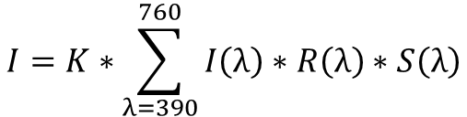
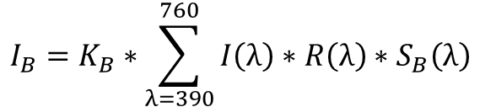
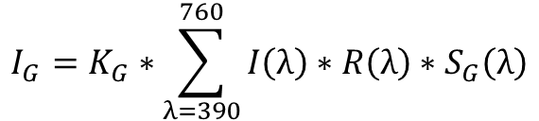
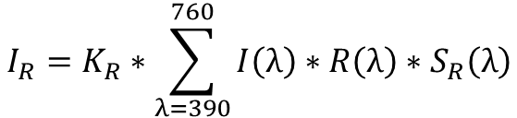
Generating color effect: Computational simulation
$$I_{R}=K_{R}∗\sum_{λ=390}^{760}{I\left(λ\right)∗R\left(λ\right)∗S_{R}\left(λ\right)}$$
$$I=K∗\sum_{λ=390}^{760}{I\left(λ\right)∗R\left(λ\right)∗S\left(λ\right)}$$
$$I_{G}=K_{G}∗\sum_{λ=390}^{760}{I\left(λ\right)∗R\left(λ\right)∗S_{G}\left(λ\right)}$$
$$I_{B}=K_{B}∗\sum_{λ=390}^{760}{I\left(λ\right)∗R\left(λ\right)∗S_{B}\left(λ\right)}$$

Slide 17
Spectral response of sensors: Computational exercise
Spectral combination 1
Spectral combination 1
Spectral combination 1
Similar scene – different light source and camera sensor

Slide 18
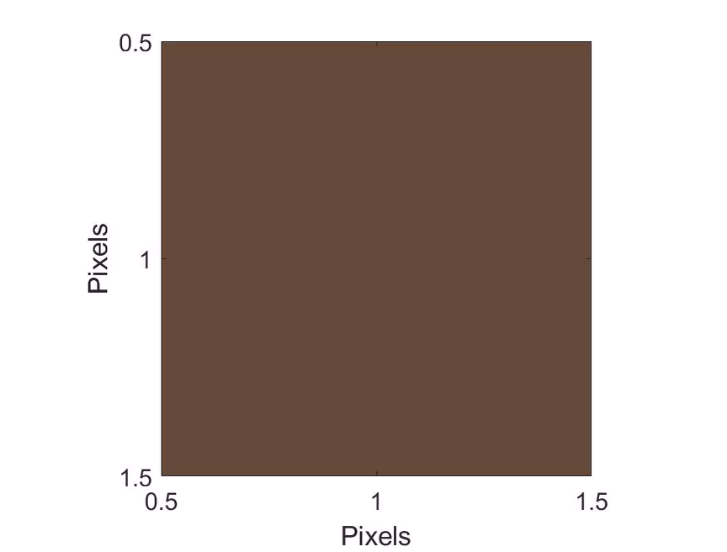

Resolution effect:
Ojo: esta característica generalmente se refiere a la cantidad de pixeles utilizados para representar una escena.

Slide 19
Thanks!
Juan Carlos Briñez de León
juan.brinez@pascualbravo.edu.co
jcbrinezl@unal.edu.co
19

